Slide 1
Introduction to serverless computing with Azure
Speaker name

Slide 2
The “evolution” of application platforms
Notes:
All good things begin with a story.
So before I talk to you about serverless, I wanted to discuss some history of how apps have been built through the years and how that has led us to the computing options we have today.
Buy your own hardware and software
Run it in your own data-centers
Deal with a multitude of questions
# of servers
Physical security
Hardware failure
Software patching
Backup
Essentially a lot of questions, not all of which might be directly related to running your business. For example, if you are running an insurance company, you want to spend your time growing and innovating in the insurance domain, not worrying about how to handle servers.

Slide 3
What is the right size of
servers for my business needs?
How do I deploy new code to my server?
What media should I
use to keep backup?
What happens in case of
server hardware failure?
Which packages should be on my server?
What size of servers
should I buy?
Who monitors
my App?
How often should I backup my server?
How can I scale my app?
How can I increase server utilization?
Who has physical
access to my servers?
Which OS should I use?
Do I need secondary network connection?
Are my server in a
secure location?
What happens if the
power goes out?
Who monitors
my Servers?
Do I need a UPS?
What storage I need to use?
How many servers
do I need?
How can I dynamically configure my app?
It takes how long to provision a new server?
How often should
I patch my servers?
On-Premises
The “evolution” of application platforms
Notes:
All good things begin with a story.
So before I talk to you about serverless, I wanted to discuss some history of how apps have been built through the years and how that has led us to the computing options we have today.
Buy your own hardware and software
Run it in your own data-centers
Deal with a multitude of questions
# of servers
Physical security
Hardware failure
Software patching
Backup
Essentially a lot of questions, not all of which might be directly related to running your business. For example, if you are running an insurance company, you want to spend your time growing and innovating in the insurance domain, not worrying about how to handle servers.

Slide 4
What is the right size of servers for my business needs?
How can I increase server utilization?
How many servers do I need?
How can I scale my app?
How often should I patch my servers?
How do I deploy new code to my server?
How often should I backup my server?
Which OS should I use?
Which packages should be on my server?
Who monitors my App?
On-Premises
IaaS
The “evolution” of application platforms
Notes:
Along came the cloud, and provided some relief from some of those questions.
IaaS in the cloud, allowed you to forget about managing all that physical hardware. Instead of hosting it yourself, you could now utilize servers hosted by someone else. While the worries around managing physical infrastructure are gone, there are a number of questions that still need to thought about:
How many virtual machines do I need?
How many would I need in future when my usage grows?
How to handle updating the servers for the latest security patches
How to think about deploying my code and the various dependencies, such as application runtimes, to the server
Who monitors my apps and so on
This means that you still haven’t reached that ideal state where you could focus purely on your business and its problems.

Slide 5
What is the right size of “servers” for my business needs?
How can I increase “server” utilization?
How many “servers” do I need?
How can I scale my app?
On-Premises
IaaS
PaaS
The “evolution” of application platforms
Notes:
Well, the cloud continue to help with that problem and with the advent of PaaS, there was even more simplification. PaaS allows you to just worry about your app, and let the cloud vendor take care of not only the physical hardware, but also the ongoing management of the operating environment like Operating Systems, Virtual Machines or Containers, as well as the various application runtimes, whether it is Java Runtime, .NET, Node.js, and so on.
You are not completely free from thinking about servers however, since you still have to worry about how to scale your app and accordingly specify the number and size of the various compute resources your apps would need at various times.

Slide 6
How do I architect my app?
Serverless, the platform for next gen apps
On-Premises
IaaS
PaaS
Serverless
The “evolution” of application platforms
Notes:
The latest in this series of evolution is Serverless – which further abstracts the underlying infrastructure from you, and allows you to focus only on a single question – how are you going to build your app to achieve the best results for your business, or whatever it is that you are trying to do with your apps.
Whether it is the code to delight your customers through a great experience, or the logic to communicate securely with a business partner, that is where most organization want to spend their creative energies on.
And serverless allows you to do just that, focus on your code and forget about the infrastructure.
This is why we believe it is the platform for next generation of apps.
Now before we jump into explaining the benefits of serverless, let’s call out what it’s not. It’s not the total lack of servers, that would a bit difficult. Instead, it’s a system where you don’t have to think about Servers at all, so for you, they are invisible.

Slide 7
What is “serverless”
Abstraction of servers
Event-driven scale
Sub-second billing
Notes:
Abstraction of servers, infrastructure and configuration of operating system
Event-driven scale
Sub-second billing
Stateless

Slide 8
Benefits of “serverless”
Micro-pricing
Ease of scale
Manage less
Notes:
“Pinnacle of PaaS compute”
Not just hardware “servers”, but software servers are also managed for you
Focus on business logic, not solving technical problems not core to business
Lower effort to get started makes it easier to experiment (bots, etc.)

Slide 9
Serverless application platform components
Functions
Execute your code based on events you specify
Notes:
Good after noon everyone. Very excited to be here to talk to you about why exactly it is that Microsoft would just not stop talking about this serverless thing – whether it is our CEO or just us measly product managers.
Now the concept that I want to talk about is that of a platform, not an individual service, but a collection of fully managed services that come together and allow you to build serverless applications.
When we talk about serverless, the first thing that obviously comes to mind is Functions-as-a-Service. Basically the ability to execute custom code, on demand, without having to worry about where the code is executing, or how it would scale if the demand goes up. This is what Azure Functions does for you. We will go into details later but that is the basic thing to remember.

Slide 10
Serverless application platform components
Logic Apps
Functions
Design workflows and orchestrate processes
Execute your code based on events you specify
Notes:
Now let me talk about Logic Apps. How many of you have heard about Logic Apps? This service was actually introduced before Functions. And I want to talk about why this service is an important part of the serverless story.
Imagine you are drawing a flowchart that represents a certain process in your business. For example - when a new customer record is created in my CRM system, go ahead and create a project in my project management system, and then send a notification email to these 3 people. We need to have processes like these all the time.
What if you could just convert these flowcharts, with a few clicks of your mouse, into real applications that actually do those things?
Azure Logic Apps effectively does that for you. Through a visual design experience, you can create workflows, that could have multiple steps. And each step could be performed by a different first party or 3rd party service, or even an Azure Function that you might have written.
And goes without saying that you don’t have to worry about where all of this processing is happening – a server, a VM, a container or whatever else. You focus only on the what, not on the how.
In a way this experience is not only serverless, but from a user’s perspective, it is often code-less.

Slide 11
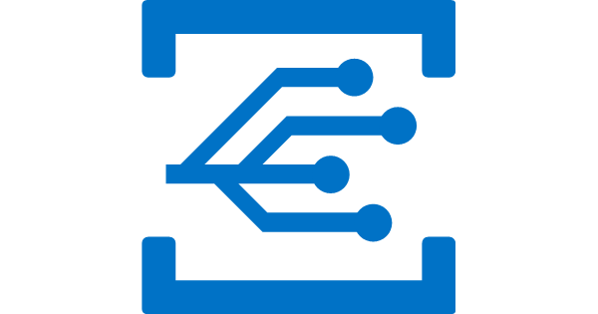
Serverless application platform components
Event Grid
Logic Apps
Functions
Manage all events that can trigger code or logic
Design workflows and orchestrate processes
Execute your code based on events you specify
Notes:
Now lets talk about Event Grid, the latest entry in our serverless toolkit. It is a fairly new service. We announced its general availability just recently.
If you think about it, in many ways the popularity of these instant scale, pay as you go compute services can be attributed to the fact that modern computing is all about events. And these events need to be responded to. Whether it is IoT devices sending signals to a central location, users performing some actions on their mobile apps, or even some systems communicating with each other. All of these are examples of event-driven scenarios in which there are certain events that need to be processed.
But how do we manage all these events? This is where Event Grid comes in. This service makes it super easy by providing a single simple interface for managing all your events. Things like:
Where these events are coming from – whether it is a storage change, a database change, a resource being provisioned, or a new user being added to your subscription
And where these events are headed to – whether you need to invoke an Azure Function or an Azure Logic App to respond to this event, or even some other destinations.
We believe that for modern apps an event is an important enough entity that we should make it a first class citizen of Azure, and take away the burden of managing events in either produces or consumers of these events. This is what Event Grid does.

Slide 12


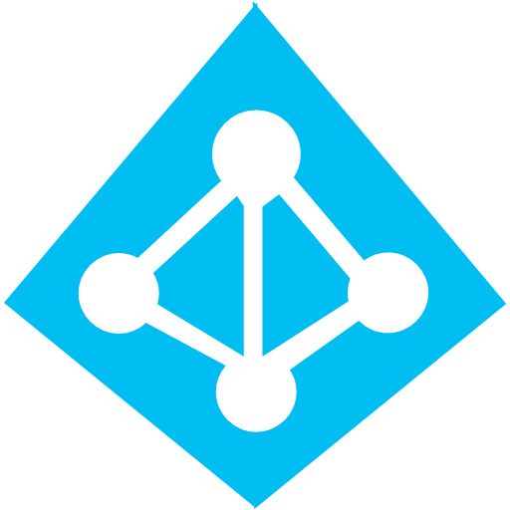
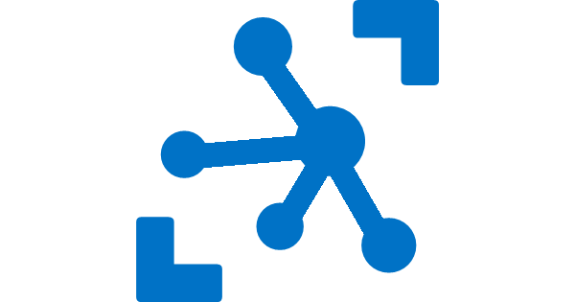


Serverless application platform components
Platform
Event Grid
Logic Apps
Functions
Manage all events that can trigger code or logic
Design workflows and orchestrate processes
Execute your code based on events you specify
Database
Storage
Security
IoT
Analytics
Intelligence
Notes:
OK now that we have the basic building blocks of serverless computing – what do you want to do next?
We are building applications after all. And applications don’t exist in vacuum. They talk to databases, they enable authentication for their users, if it is an IoT app, it potentially receives data from and sends data to IoT devices. Maybe they need to processes that data to prepare it for further analysis, and more and more applications these days are required to have some kind of intelligence in them.
How do we achieve these things in our apps? It wouldn’t be fun if our application code was running in a serverless environment but we still had to manage an army of Virtual Machines to perform these other tasks. We need serverless services for serverless apps. And this is what Azure provides us – we have Cosmos DB, a globally distributed, elastic scale database, a perfect ally for your serverless apps. We have Azure Active Directory (AAD) and AAD B2C for your security and access control needs, IoT Hub solves your IoT needs. You have services like Event Hubs and Stream Analytics to ingest and analyze real-time streaming data. Lastly, we have the Microsoft Cognitive Services API to provide intelligence in your apps.
All of these services together comprise the Azure Serverless application platform. Using these pieces you can compose your applications.

Slide 13

Serverless application platform components
Development
Platform
IDE support
Event Grid
Logic Apps
Functions
Manage all events that can trigger code or logic
Design workflows and orchestrate processes
Execute your code based on events you specify
Integrated DevOps
Local Development
Monitoring
Database
Storage
Security
IoT
Analytics
Intelligence
Visual Debug History
Notes:
So we have a platform now. But how about the process of building these applications? How does the developer experience look like?
How many of you were at the vision keynote yesterday? Satya and his friends – with a combined IQ of 5 million – sitting and talking about Quantum computing. Just like you, I understood everything.
Anyway, the thing that strikes me is this – Quantum computing is in the works, it hasn’t arrived yet. But the programming language, the Visual Studio experience are already here. This is Microsoft. If there is one thing we do right – it is the developer experience. Even in the cloud world, we don’t subscribe to the mentality that just because you are reaping the benefits of running application in the cloud, you can be subjected to pain and heartburn while building those apps.
So for serverless apps, we provide full E2E development experience through tools like Visual Studio and VS Code. We in fact support unique features like the ability to build, test and debug your applications locally on your dev machines, before even deploying them to the cloud. This is a massive productivity boost while building cloud apps and something no other cloud vendor can match. These technologies support continuous deployment so you can easily integrate them into your existing deployment pipelines. And finally, we provide full monitoring support through Azure Application Insights to monitor your apps in production.
So that is how we think of a comprehensive serverless application platform in Azure.
Now, I would like to invite Chris back to do a demo and show some of these services in action. Chris.

Slide 14
Scenarios for Serverless
Anything that needs to respond to events
Real-time stream processing
Timer-based processing
Millions of devices feed into Stream Analytics
Transform to structured data
Store data in SQL DB
Every 15 minutes
Find and clean invalid data
Clean table
Backends (Mobile/IoT/Web)
Real-time bot messaging
?
...
Photo taken and WebHook called
Stores in blob storage
Produces scaled images
Message sent to Chatbot
Chatbot sends
response
Cortana Analytics answers questions
Notes:
So what kind of apps and scenarios can be built using serverless technologies? This is not a trick question because I have already given you the answer.
Anything where there is need to run some code or logic in response to an event. You will notice that this is a very broad definition and covers a vast array of scenarios. So let me provide some examples:
Real-time stream processing: IoT devices sending data that needs to be analyzed, enriched and archived somewhere. This is best done using serverless functions which can be spun up on demand, because you don’t know when the data is going to come in and how much data is going to come in. So, you don’t necessarily want to build your own infrastructure for peak capacity.
Almost every organization needs to run some regular tasks like de-duplication of database entries at the end of every day or collecting logs at the end of every week. Such tasks that need to be run only at specific times and only for a few seconds each time, don’t call for dedicated infrastructure. They are best left to serverless solutions.
Building backends for your mobile, IoT or even web apps is also a popular use-case for serverless architectures: In this diagram you see a mobile app sending an image to a function which stores it in Azure Storage. This action triggers another function which creates multiples thumbnails out of the original image. Being able to perform these action in a serverless manner, takes away the burden of the mobile developer from worrying about the backend.
Bots are all the new rage: Automated response systems receiving a customer request is an event. Building intelligent bots for such scenarios using serverless technology is again a great example where the focus needs to be on logic instead of infrastructure.
These are only some of the many examples which fit well with serverless.

Slide 15
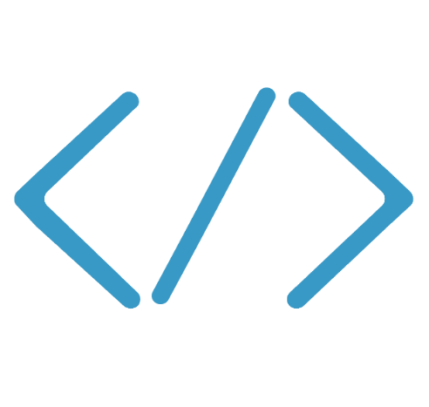

Functions
Code
Azure Functions
Events & Data
Develop locally using best of class developer tools
Boost productivity through triggers and bindings
Choose from a variety of programming languages
Integrate with existing DevOps processes
Notes:
We already saw how Functions provide an experience of responding to events through code that in turn processes data that could be coming from or headed to any number of services. Some of the key highlights are:
Ability to build, test and debug your Functions code locally on your own machine before your code is even deployed to the cloud. This is a massive productivity benefit while building cloud applications and something Azure provides through rich integration with a world class developer tool like Visual Studio
Secondly, unique features like triggers and bindings that make it super easy to setup event-driven architectures and simplify communication with data sources
Thirdly, we support a number of programming languages. In the demo we saw an example with C#. But we also support Node.js, F#, Python and even bash so you can pick the language of your choice to write serverless functions with
Lastly, Functions support concepts such as Continuous deployment, which makes it super easy to integrate them into your existing DevOps pipelines.

Slide 16

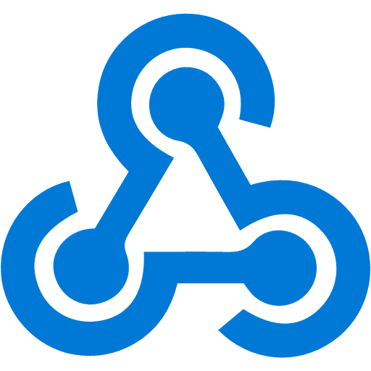




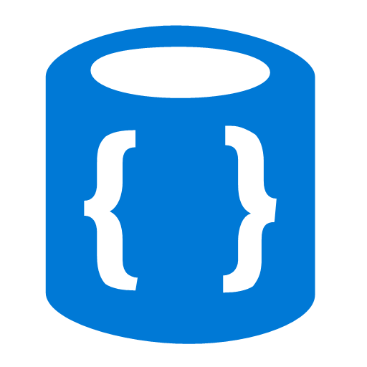


Azure Functions
Events
Code
Outputs
React to timers, HTTP, or events from your favorite Azure services, with more on the way
Author functions in C#, F#, Node.JS, Java, and more
Send results to an ever-growing collection of services

Slide 17
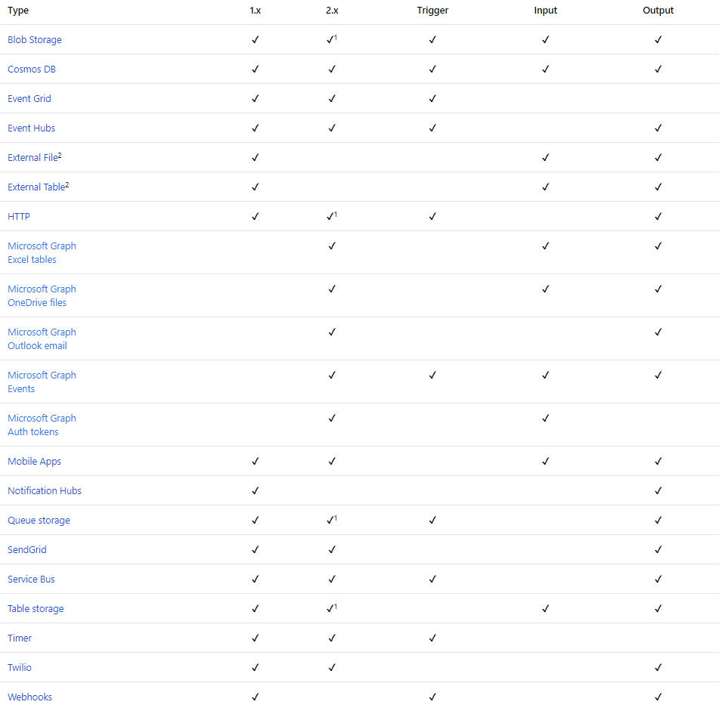
Functions triggers and bindings
Notes:
As I mentioned earlier, triggers and bindings are the things that facilitate easy communication with other services. This chart shows us the triggers and bindings currently supported. As we can see, there are a number of Azure services supported here…. for Storage, Database, Messaging, Notifications and so on. In addition to those, Functions also support generic Http triggers, which means you can easily write a piece of code that can be used to respond to REST requests or requests from any service that supports webhooks. This also provides a really fast and easy mechanism for building extensions to SaaS applications. We are fully committed to making this list grow and making more check-marks appear in that table.

Slide 18
Demo
Functions
Notes:
Demo Thiago did in Brazil:
Pre-create a Function App on the portal and open it in the portal
How to create an Azure Function in four different ways
Call out that the host used by all four is the Functions Core Tools, which is the same code running on Azure to host the functions
Type one: from the portal
Create a new HTTP Triggered C# or Node function in the pre-created Function App
Explain the function app is where you put functions that form the same microservice, and share the same
Show all the different templates you have the option to choose, with different triggers and languages
Once the HTTP Triggered C# or Node function is created, explain the template code quickly, get the function URL from the “Get Function URL” link
Use browser to call it, show the message asking for a name
Add ?name=<your name> to the query string and call it again and show it says “Hello <your name>”
Type two: from the Azure Functions Core Tools CLI
Pre-install the functions core tools (v2 if you’re using a Mac) https://docs.microsoft.com/en-us/azure/azure-functions/functions-run-local#install-the-azure-functions-core-tools
Create a new folder
Create a new local function app with “func init”
List the files created and explain these are related to the Function App that you explained in the portal
Create a new local function with “func new”, choose either C# or Node, and choose HTTP Trigger
Start the function locally with “func host start”
Get the URL from the function in the logs in the cli and call it from a browser, curl or from Postman
Type three: from Visual Studio Code. Install the Azure Functions extension to Visual Studio Code
Use the Visual Studio Code command (Command P or Control Shift P) and enter > Functions. You should have an option to create a new Functions Project
Create a new project, choose the same templates as before
Use the command again and create a new Function in the Functions Project
Go to the Debug tools section of Visual Studio Code and click the play button to “Attach to Azure Functions”
This should start the CLI with the host, and attach to the process
Put a breakpoint in the code
Copy the URL from the function
Go to browser/curl/postman and make a call
Show that the breakpoint is hit
Type four: Visual Studio
Make sure you have the latest Visual Studio 2017, and with the latest Azure Functions and Web Jobs Tools extension https://marketplace.visualstudio.com/items?itemName=VisualStudioWebandAzureTools.AzureFunctionsandWebJobsTools
Create a new function app with File -> New -> Azure Function
Select HTTP Trigger
Explain that this is a compiled class library, and not script, so they can bring in all their .NET Full Framework or .NET Core dependencies into the project
Put a breakpoint in the code
Start debugging
Show that the func runtime starts too
Hit the site URL and show that the breakpoint was hit
Finally, mention that great support for Visual Studio for Mac is coming (the current edition is Mono based)

Slide 19
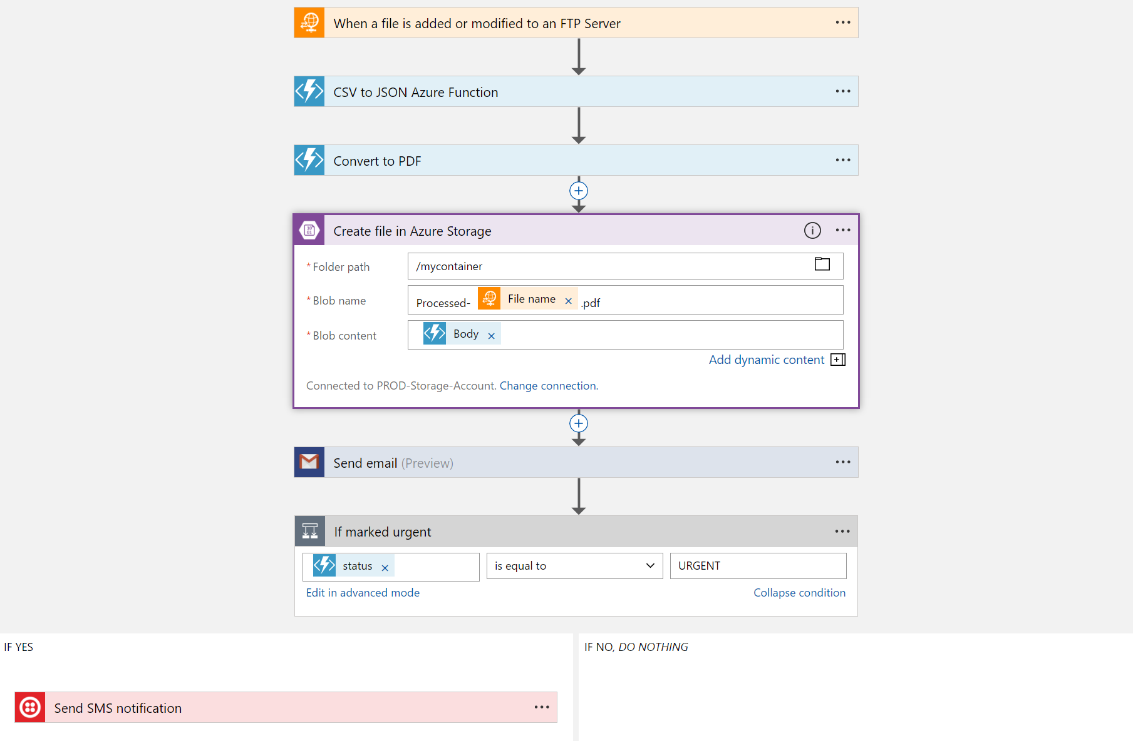
Logic Apps
Visually design workflows in the cloud
Express logic through powerful control flow
Connect disparate functions and APIs
Utilize declarative definition to work with CI/CD
Notes:
Moving on to Logic Apps
Logic Apps is a service that provides a visual design experience for creating serverless workflows in the cloud without writing any code.
No matter how complex your business logic is, you can express it using the powerful control flow available in Logic Apps.
Another key value of this service is that, it provides connections with multiple services and allows you to orchestrate all these services along with the functions which you or someone else in your organization might have written.
Lastly all of these workflows are internally represented using a declarative definition format, again making it very friendly with your existing CI/CD practices

Slide 20
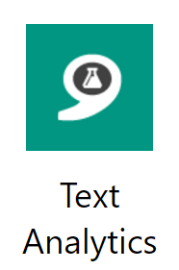
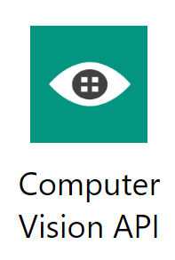
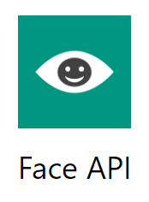
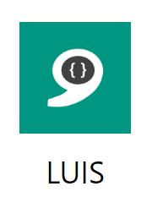
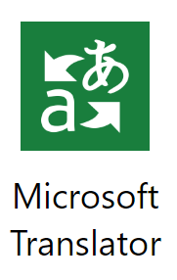
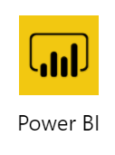

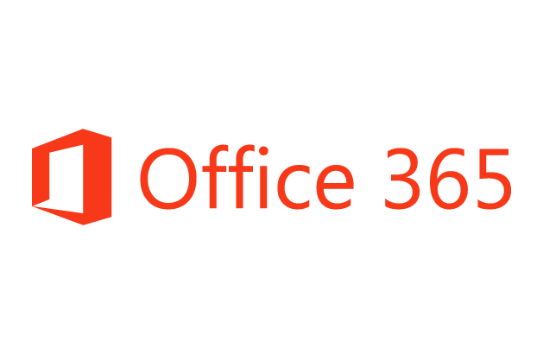
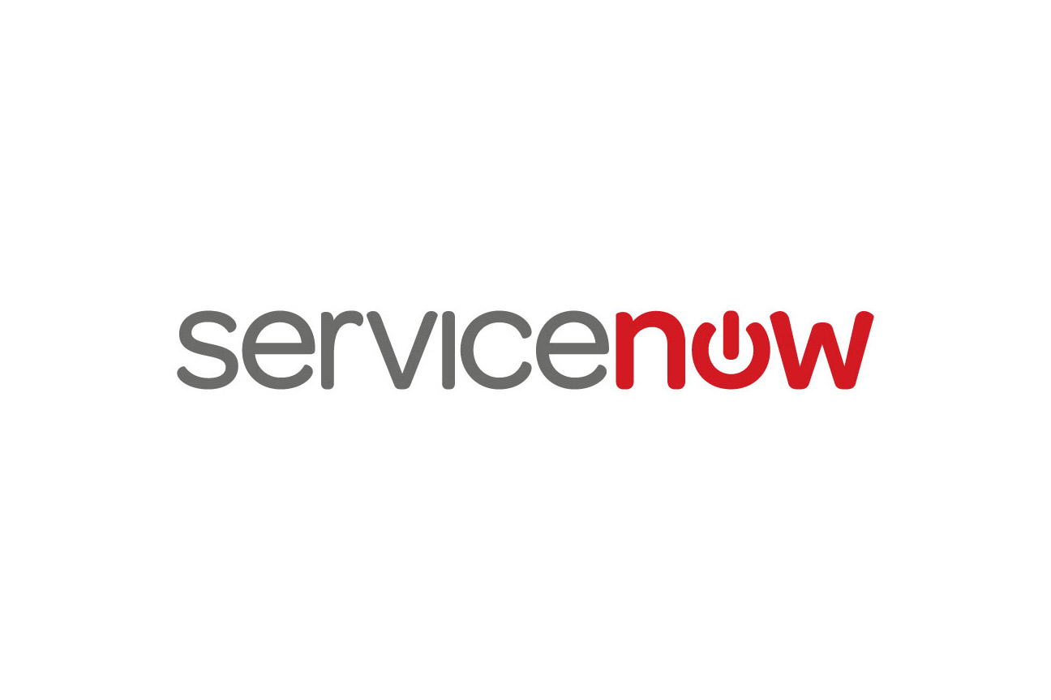
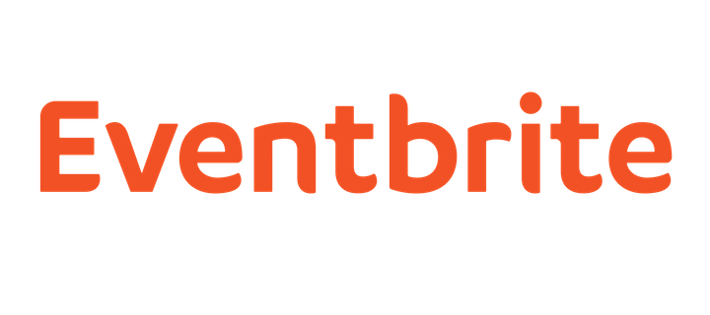




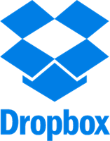




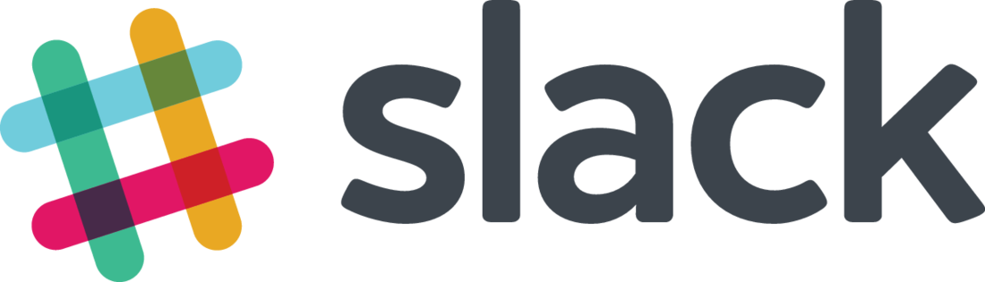
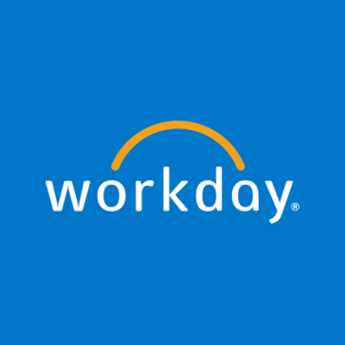

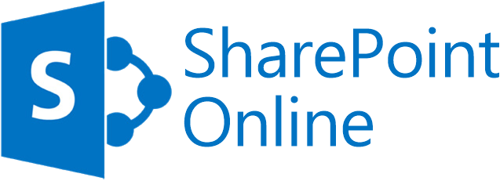



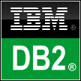
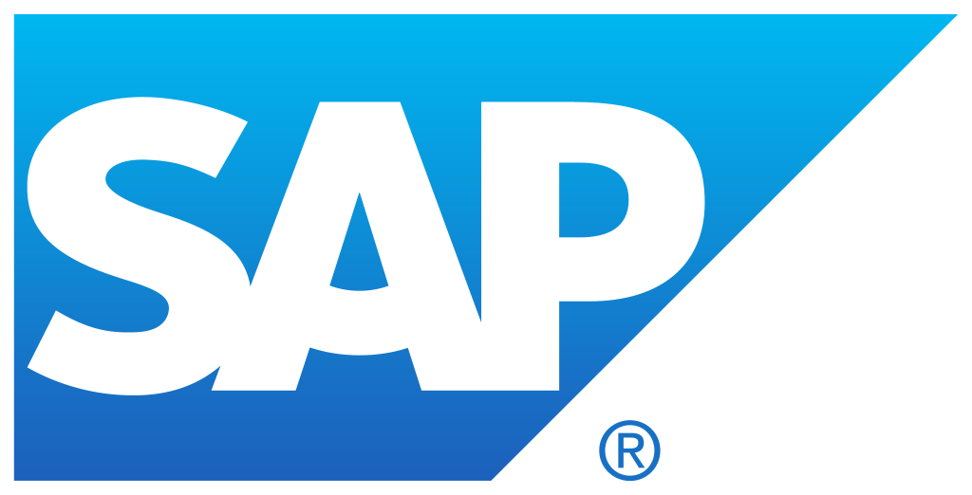

Logic Apps connectors -~200 and growing, build your own
Azure API Management
Azure Service Bus and Event Grid
Azure Functions
Azure Active Directory
Azure App Services
Azure Blob
Azure CosmosDB
Azure Data Lake
Azure SQL
Azure Resource Manager
Logic Apps
On-premises data
gateway
BizTalk Server
Notes:
Logic Apps support more than 180 connectors already. It goes without saying that it supports most Azure services but you can see from this list that it also supports many popular 3rd party services like Dropbox, Twitter, Salesforce and so on.
And it does that without requiring you to understand how any of these other services work. It completely abstracts the integration details of how to communicate with these other services and their specific API, SDKs and protocols.
And now to talk about the details of Azure Functions, let me call back the person who has been working on this thing before it was a thing. Chris.

Slide 21
Demo
Logic Apps
Notes:
Demo that Thiago did in Brazil:
Showed an existing logic app based on this exported ARM template:
https://github.com/nzthiago/twittermonitorlogicapp
Talked about how I use it to monitor new tweets, check that the user has more than 50 followers, and then sends a message to teams
Showed all the other connectors you can use
Showed the Teams channel that the logic apps is writing to and showed all the tweets it had been monitoring for me

Slide 22


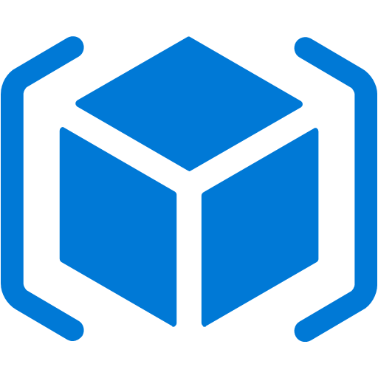

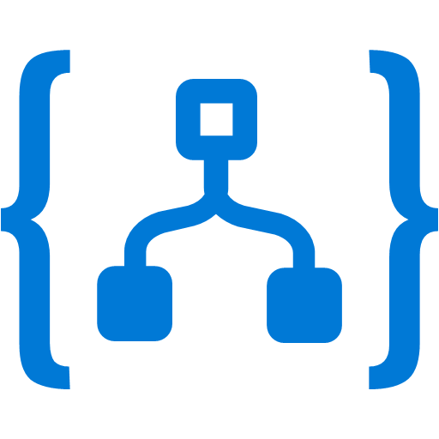



Event Grid
Event publishers
Event handlers
Manage all events in one place
Focus on innovation and pay per event
Unlock new scenarios for your apps
Ensure reliability and performance for your apps
Blob Storage
Azure Functions
Resource Groups
Logic Apps
Azure Subscriptions
Azure Automation
Event Hubs
WebHooks
Custom Events
Notes:
Now, I would like to describe the capabilities of our core serverless services, in a little more detail, this time starting with Azure Event Grid.
We already talked about how important events are.
This service allows you to manage all events in a single place
Notice that multiple Azure services today publish their events into Event Grid and these events can be routed to multiple destination. We have Functions, Logic Apps and even other services like Automation and generic webhooks.
You can also create your own customer events
The rich set of publishers and consumers opens up many interesting scenarios for you to construct already. And the list of services that will publish their events to Event Grid will continue to grow over time.

Slide 23
Event Grid delivers at massive scale
Sub-second end-to-end latency in the 99th percentile
10,000,000 events per second per region
24-hour retry with exponential back off for events not delivered
Near real-time
Massive scale-out
High reliability
Notes:
In terms of performance and scale, Event Grid makes some strong guarantees.
Sub-second e2e latency in the 99th percentile, which is as close to real-time delivery as it gets
An ability to route about 10 million events per second, so massive scale
And, an intelligent logic to retry the event delivery if the first time doesn’t succeed
All of these make Event Grid a very powerful event backbone for your serverless applications.

Slide 24
Demo
Event Grid
Notes:
Demo that Thiago did in Brazil:
Pre-created a storage account of the ‘storage’, not ‘generic’, kind in West Central US
Pre-created an Azure Function of the “Event Grid Trigger” type
Explained that storage has a resource extension for event grid, so the events are being created directly by the storage account, but you can use it for your own custom event topics too
Opened the blob storage, created a container
On another browser tab opened the Azure Function that was precreated, and showed the live logs (select your function inside the function app and click the little ‘logs’ tab at the bottom of the pane, from below the function code)
Went to the storage tab and uploaded a file to that blob storage container (you could use Storage Explorer too)
Quickly switched to the tab with the function and logs opened, and showed it had already executed the function. Showed in the logs that it points to the new file I uploaded

Slide 25

“We were able to move development along smoothly and cost-effectively, even when unexpected issues arose, by taking advantage of Azure capabilities”
JYuki Chiba
Design Leader,
Advanced Solutions Group
Transformed its popular IMAGE WORKS service through Azure serverless technologies.
Benefits:
Latency reduced by 95%
Development time reduced by 75%
Higher reliability
Ability to add new features and releases faster and more frequently
Notes:
We have many customers who have seen success with serverless technologies. Today we want to talk about a few of them:
First one is FUJIFILM.
They had a very popular image management/sharing service that handled more than a terabyte of data each day.
They were looking to improve the customer experience by providing better reliability and lower latency in the service
Another goal was to rearchitect their service in a way that allows them to add future enhancements more quickly and at a faster cadence
In the previous version of the service, they found that they were spending an inordinate amount of time in dealing with things that had nothing to do with the core business – things like managing the infrastructure, worrying about adding more servers when demand goes up, and so on.
When they moved to serverless architecture, they didn’t have to do any of that, and they saved 75% time on their development costs.
And when they started building the actual service, by the virtue of using Azure Functions, they could very naturally adopt a microservices architecture which decouples the development efforts of different teams and allows you to introduce enhancements to the system without disrupting the existing service. This improves the uptime of the service.
Also, by the virtue of using Cosmos DB, a fully managed, planet scale DB for their serverless app, they were able to reduce the overall latency by 95%, far exceeding the goals they had set for themselves.

Slide 26

“Azure Functions enables a pay-for-what-you-use compute model at micro-penny rates. That saves significant Capex infrastructure investments, as well as Opex costs”
Curtis Johnstone
Distinguished Engineer,
Platform Management Business Unit
Took a serverless architectural approach for their SaaS, deploying key Azure capabilities to build a scalable platform.
Benefits:
Platform able to manage millions of objects
Cut time-to-market by two-thirds.
No costly on-premises hardware or spinning up VMs in the cloud.
Notes:
Quest is a great example of a SaaS application built on top of serverless technologies. They built a solution to help their customers manage their Office 365 and Azure AD environments. They built it as a SaaS solution entirely based on Azure serverless technologies like Functions, Cosmos DB, Event Hubs.
As a result they saw faster time to revenue and massive scale in addition to the regular cost and effort benefits.

Slide 27

“The cloud means more for us than lower costs, less effort, or faster innovation. The services we deliver would simply not be viable without Azure cloud and serverless technologies”
Richard Stinear
Head of Engineering
Used Azure serverless computing to create a new class of features that help retailers respond to new opportunities and make shopping more rewarding for consumers.
Benefits:
Better customization for customers
Reduced costs and efforts
Scale on demand
Notes:
Plexure is a very interesting story.
They build a solution for retail companies. They use technologies like IoT and Machine Learning to collect signals about user actions and then they use this data to help their customers fine-tune their marketing efforts to their customers.
The interesting part is that not only they built this solution on top of the Azure serverless platform, but they also allow their customers (the retail companies) to extend the capabilities of this platform by providing their own code. Plexure runs this code on behalf of their customers using Azure Functions. So, this is like the serverless within serverless. Its like Inception-less.
Anyway, so in addition to the regular benefits they found a great benefit. Earlier they had to spend a bunch of time building custom functionality for specific customers. Now, they just let their customers extend their solution.

Slide 28
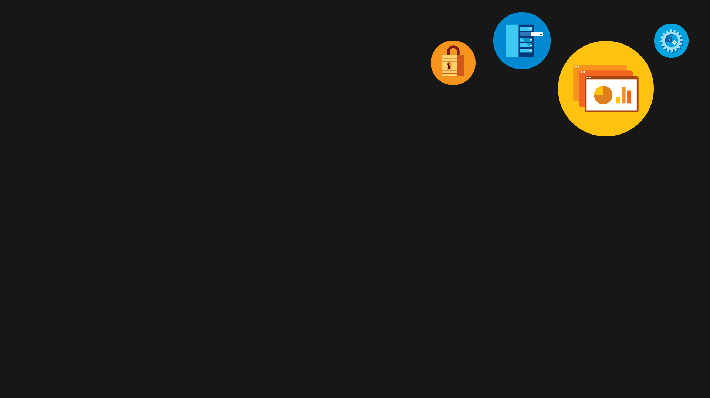
Main takeaways for Serverless:
The glue of the cloud
Sub-second billing
Scale on demand
Focus only on your code!

Slide 29
Follow us on Twitter
@AzureFunctions
Follow the Functions team for our blogs:
aka.ms/AppServiceBlog
Try Functions now, without a credit card…
aka.ms/TryFunctions

Slide 30
Access all Content and Videos for Microsoft Tech Summit on the Microsoft Tech Community at: techcommunity.microsoft.com
Questions? Visit the Microsoft Tech Community in the Hub!

